Slide 1
Machine Learning Fairness
Group 9
Liu, Yunfan / Shi, Mingrui / Tang, Qingyang / Zhang, Haoyu / Zhang, Zerui

Slide 2
Executive Summary
Goal: Algorithms Comparison
Prejudice Remover Regularizer (A5)
Handling Conditional Discrimination (LM and LPS) (A6)
Result
Local messaging (A6 LM) performs best in accuracy and calibration trade off with 96.7% accuracy and calibration score 0.006
Prejudice Remover Regularizer (A5) reduces calibration to 0.00016, but it sacrifices too much accuracy to 0.61

Slide 3
Data Processing
Dataset: compas-scores-two-years.csv
A database containing the criminal history, jail and prison time, demographics and COMPAS risk scores for defendants from Broward County from 2013 and 2014
X: most variables except those with missing values
Y: two_year_recid
Protected attribute: race (Caucasian/ African-American)

Slide 4

Fairness-aware Classifier with Prejudice Remover Regularizer (PR)
Three Causes of Unfairness:
Prejudice: Direct Prejudice, Indirect Prejudice (PI), Latent Prejudice
Underestimation
Negative Legacy
PI:
Prejudice remover is an in-processing technique to reduce indirect prejudice, directly tries to minimize the prejudice index.

Slide 5
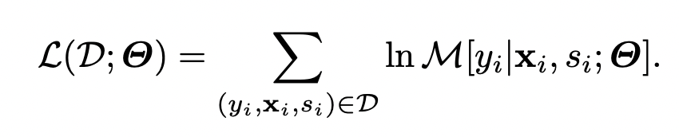



Prejudice Remover Regularizer
Parameters are estimated based on the maximum likelihood principle:
Objective function:
Prediction model :
Prejudice remover regularizer:
⇒ Objective function:

Slide 6
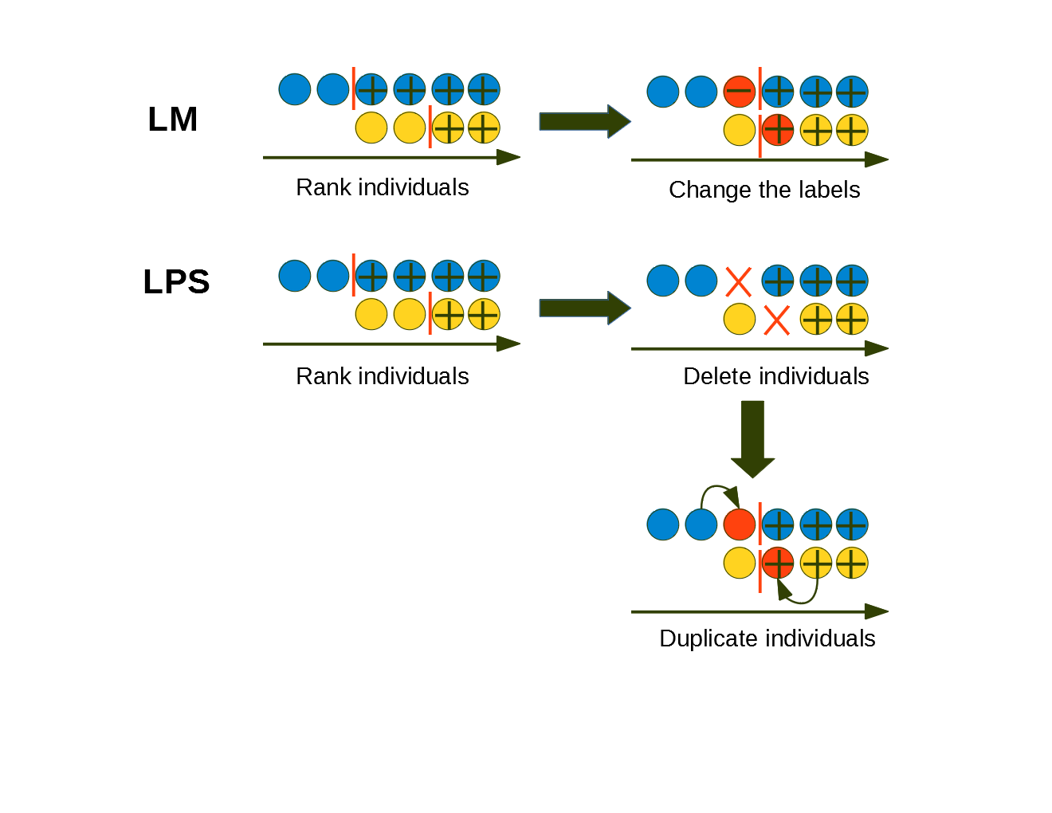
LM (Local Massaging) & LPS (Local Preferential Sampling)

Slide 7
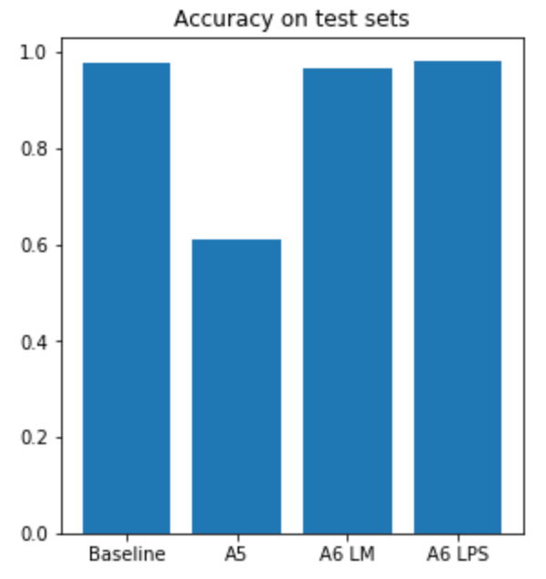
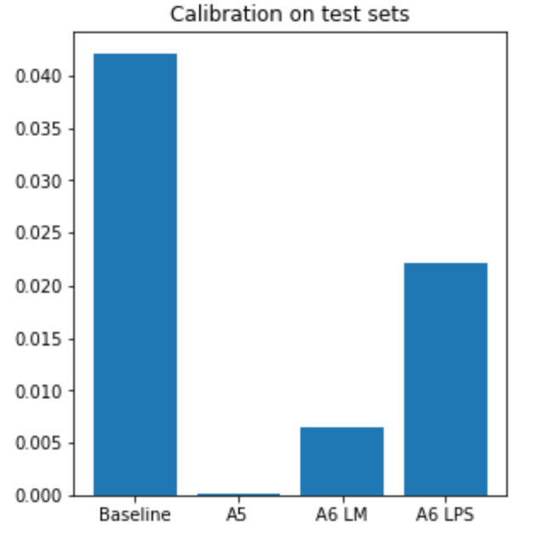
Model evaluation and comparison
Accuracy plot (Baseline, A5, A6 LM, A6 LPS)
Calibration Plot
Trade off between prediction accuracy and prejudice removal.

Slide 8
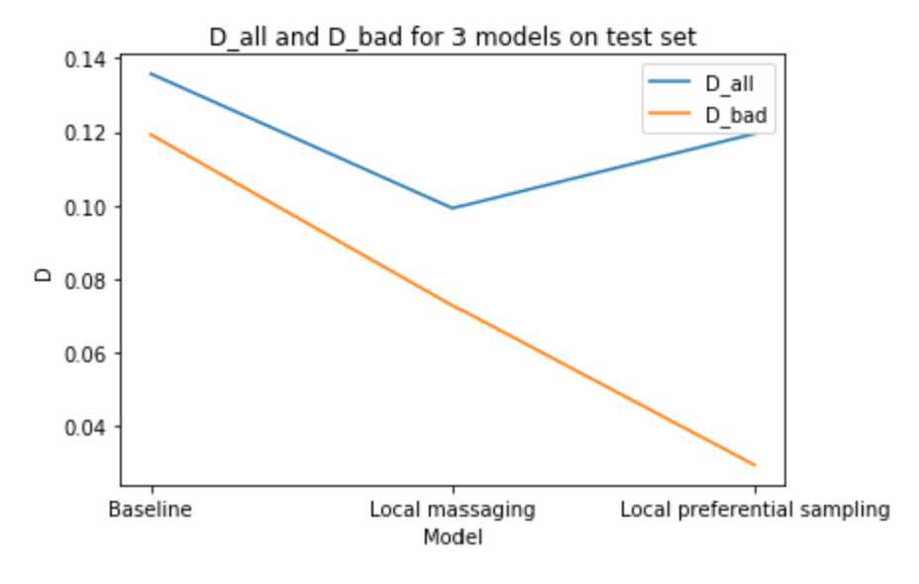
Comparision of two algorithms in A6
Both methods reduce bad discrimination, LPS reduces more than LM.

Slide 9
Summary
Local messaging (A6 LM) performs best in accuracy and calibration trade off and is generally the best one
Prejudice Remover Regularizer (A5) reduces calibration to nearly 0, but sacrifices too much accuracy. It can be used when calibration is extremely important.

Slide 10
Thank you

